Slide 1
Mobile View for Operators
Basic User Guide

Slide 2
What is mobile view JobFlow?
You will see your tasks on your mobile or tablet.
You will be able to record your time against a task.
You will be able to record actual job size (eg. ha or bales) .
You will be able to confirm products or materials used on a job.

Slide 3
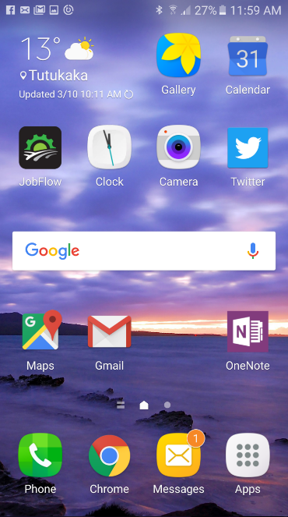
Launch
On your mobile or tablet
select “JobFlow” shortcut to launch mobile view.
Notes:
Need picture of mobile desktop here

Slide 4
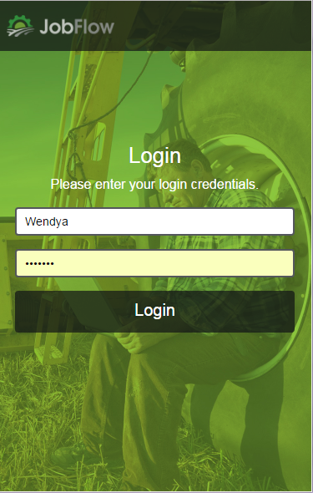
Login
Enter your login name and password.
Your device (mobile or tablet) should remember this for you.
Remember to check if YOU are logged in if sharing a device

Slide 5
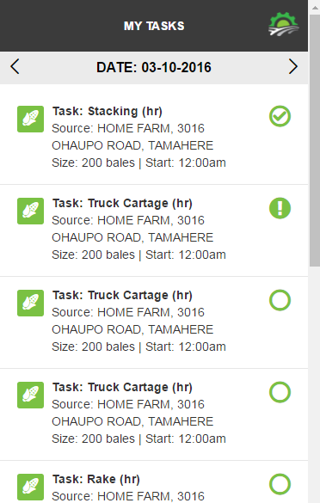
Tasks
Your tasks for today will show
They are in order so pick from the top of the task list
open task, task in progress, complete
To select the task touch it on screen
< and > arrows navigate you backwards and forwards
Notes:
Insert images of symbols

Slide 6
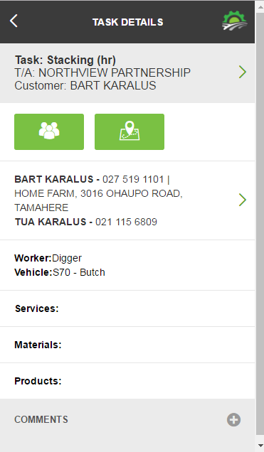
Task Details
Customer
Team and Site Info
Work Site Address
What Vehicle and/or Implements to use (check you name is here too if sharing a mobile!)
Products & Materials to take
Comments

Slide 7
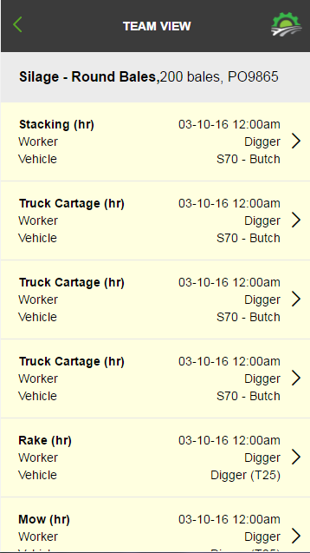
Team View
Select this button to see who is working on the same job with you.

Slide 8
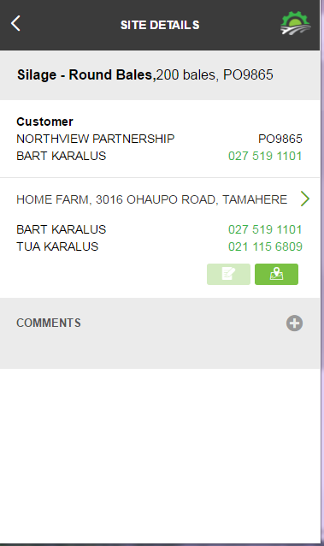
Site Details
Select this button to see more information on the Site Locations

Slide 9
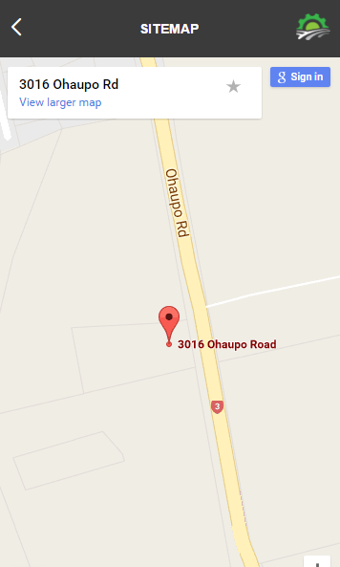
Site Map
Select any address or
again, to go to google maps

Slide 10
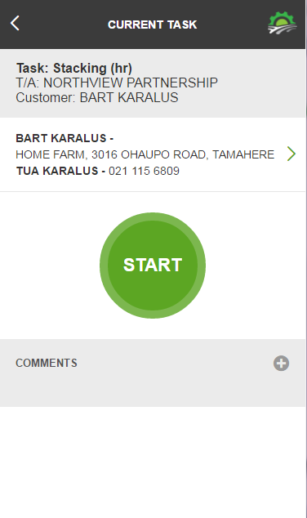
Start Task
Select the task and START to begin to record your time.
Add a comment at any time

Slide 11
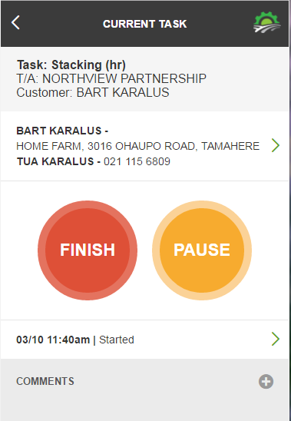
Pause Task
If you have stopped during the task – press Pause

Slide 12
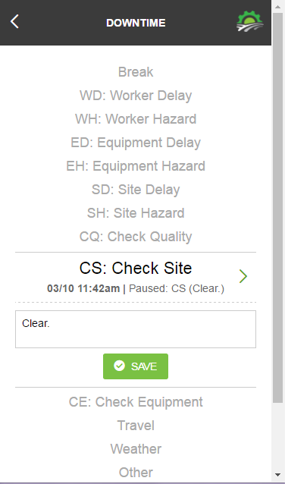
Pause Reason
Enter why you have stopped. Select a reason for downtime and make a note.

Slide 13
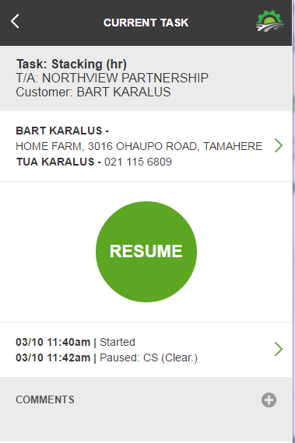
Resume
Press Resume when underway again

Slide 14
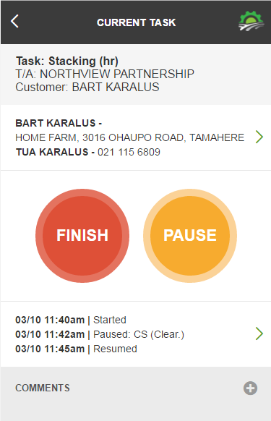
Finish Task
Press Finish

Slide 15
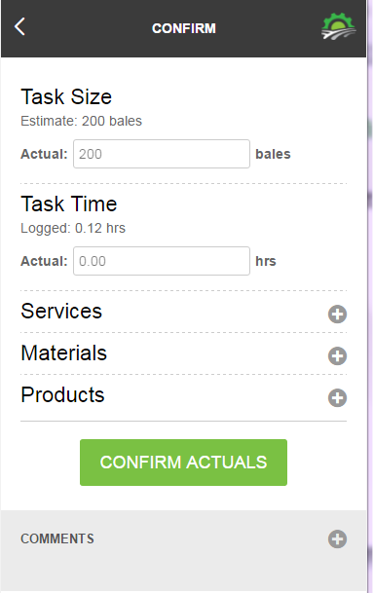
Confirm Actuals
Enter actual size
Enter actual time
Add/Enter Products or Materials used
>Select CONFIRM ACTUALS

Slide 16
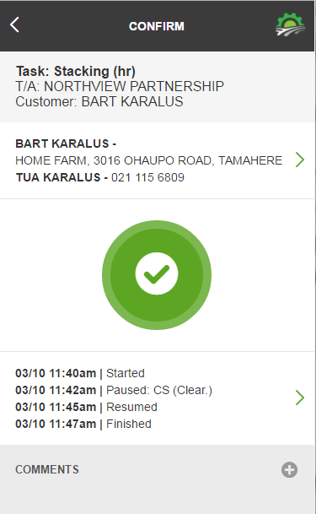
Complete Task
When you are happy you have recorded all of the information press to complete

Slide 17
Next Task
Select your next task

Slide 18
FAQ’s
What happens if I don’t have mobile coverage? The screen you are on will stay there until you go forward (enter and submit) or backward, then it will go blank lose your entry. Note your time at this point manually.

